Slide 1
EE 4583 Micro 2
January 21
Dr. Paul Morton

Slide 2
Cover Key Points of the Tilt Code
Difference between printf and PRINTF
Set up with UART and Semihosting Console vs no drivers specified
Problem with printing Negativies
2 different fixes
The mapping from Raw XY values to Servo outputs

Slide 3
You have to use PRINTF unless you provide a driver that directs the output to the UART0
PRINTF will not print signed numbers by default
Can use a workaround hack:
PRINTF("Pos %4ul %4ul Servos %c%d c%d\r\n",g_X_Cal, g_Y_Cal,g_Xout < 0 ? '-' : ' ', (uint32_t) g_XOut,
g_YOut < 0 ? '-' : ' ', (uint32_t) g_YOut );
Can change in properties:

Slide 4
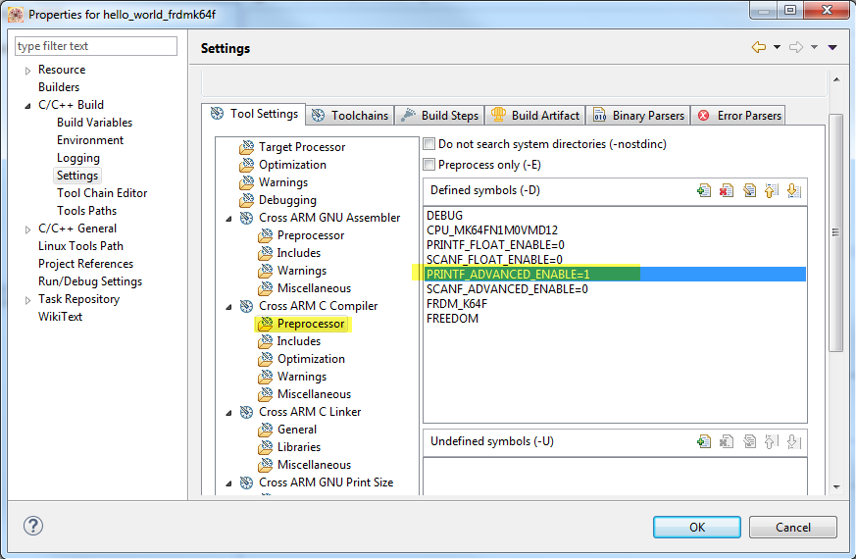
Change in Properties (Diff system)

Slide 5
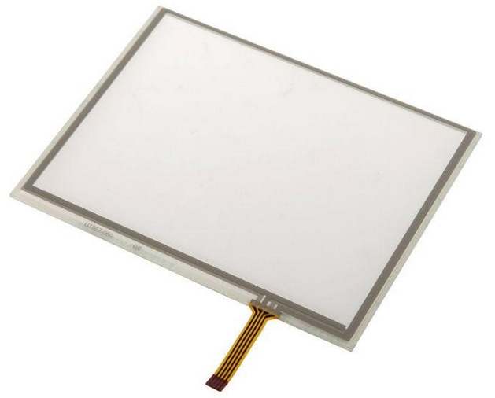
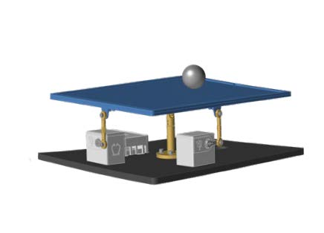

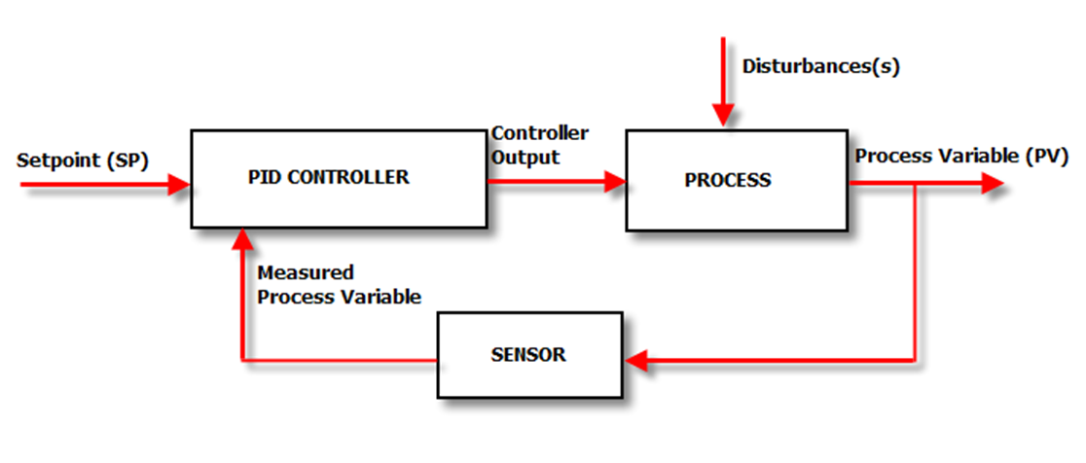
Mapping
1. Raw XY
From 100 to 3500
2. Calibrated XY
0 to 2000
3. PID Outputs
+/- 30 max
4. Servo Commands
Level + PID
We have covered the calibration and PID functions, but what about the servo commands?

Slide 6
Servo Commands
Each servo can move from level about +/- 30 servo units
The minimum down position could be 60 to 90 and the maximum up position should be 130 to 160 giving a range of 60-80
For my table I used 60 for my range
Establish the level position for X and Y: Mine are 103/110
My servos both work backward—So for me with so the ServoX_Dir = 1 and not 0
The output of the PID will be a + or – correction.
We’ll cover some considerations for adjustment next
If we just consider a proportional output only then we can calculate the value of kp gain that will give +/- 30 across the entire 0 to 2000

Slide 7
Using Kp Gain Calculate Max Servo
Kp * Max Error = 30
Max Error = 1000 – 0 or 1000 – 2000 = +/- 1000
Kp = 30 / 1000 = 0.03
Your calculations may be different
We set the Kp = 0.03 for X and Y and other gains = 0
Have to fix the integral to be 0 if Ki = 0 (add if statement)
Then run table and we should get the max table movement at the edges for both X and Y and level in center

Slide 8
Calculate the kp gain to give the max
Error = 1000 – Position
PID = +/- 0 to 30
Servo = Level X – PID X
Servo = Level Y - 30
0,2000
2000,2000
Servo = Level X - 30
Servo = Level X + 30
1000,1000
Servo Level X, Level Y
0,0
2000,0
Servo = Level Y + 30

Slide 9
Then Tune the PID from there
Note that with just Kp, you will likely have lots of oscillations and overshoot
Play with greater and lesser Kp to see it either never gives max table movement or it gives max movement before you get to the edge
The center should always be level
Then add in some Kd 0.002 to 0.006 and see how it affects the oscillations, may reduce the Kp or increase it
Play with Kp and Kd till it’s stable but able to catch giving the ball a push toward the edge or a roll on test.
Finally add in a small amount of Ki, ~0.0001 and see if it corrects to the actual center

Slide 10
Things to check
Make sure the PID returns to a float
Check to be sure you are not using unit16_t or unsigned int where you need a signed result

Slide 11
Questions

